Slide 1
Introduction to
Operating Systems
J. H. Wang
Feb. 22, 2021
OS, Spring 2021 (undergraduates)
NTUT CSIE

Slide 2
Instructor and TA
Instructor
  Jenq-Haur Wang (王正豪)
  Associate Professor, CSIE, NTUT
  Office: R1534, Technology Building
  E-mail: jhwang@csie.ntut.edu.tw
  Homepage: http://www.ntut.edu.tw/~jhwang/
  Tel: ext. 4238
  Office Hour: 9:10-12:00am on Tuesdays and Thursdays
TA
  (TBD) (@ R1424, Technology Building)
    E-mail: TBA
OS, Spring 2021 (undergraduates)
NTUT CSIE

Slide 3
Notes on Coronavirus Outbreak
Due to coronavirus outbreak, each teacher
  Is required to wear masks in class
  Should know the student attendance and where they sat very clearly
    Just for the potential epidemic investigation
  Should provide distance learning mechanisms and record the class sessions using i-School+
    For those who cannot attend the class
  Needs to establish communication channels for students
    LINE, Facebook, i-School+
OS, Spring 2021 (undergraduates)
NTUT CSIE

Slide 4
Important Notice for All
Before class:
  If you have fever, please take a leave and stay at home
  Wash your hands before/after class
In class:
  Wear masks in classrooms
  Keep the doors and windows open in the classroom
  If you have fever, cough, or shortness of breath, please wear masks and interrupt me
  You will be taken temperature by university staff
OS, Spring 2021 (undergraduates)
NTUT CSIE

Slide 5
More Information on COVID-19
For more information about COVID-19 and Taipei Tech Measures in Response to the COVID-19 Outbreak:
  https://oaa.ntut.edu.tw/p/404-1008-98622.php
Check the latest updates on the outbreak:
  https://news.ntut.edu.tw/p/422-1000-1085.php
OS, Spring 2021 (undergraduates)
NTUT CSIE

Slide 6
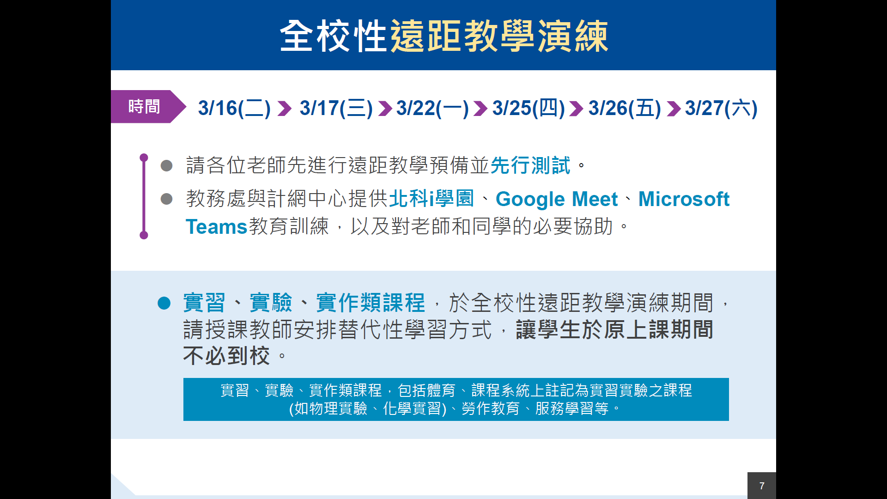
Practice for Distance Learning
OS, Spring 2021 (undergraduates)
NTUT CSIE

Slide 7
Course Overview
Course: Operating Systems
  For undergraduates, required course
Time: 13:10-14:00pm on Mondays, 10:10-12:00am on Wednesdays
Classroom: R527/R227, 6th Teaching Building
Prerequisite:
  Data Structures, Computer Organization
  Working knowledge of a high-level programming language for projects
Course webpage: http://myweb.ntut.edu.tw/~jhwang/OSu/
OS, Spring 2021 (undergraduates)
NTUT CSIE

Slide 8
Target Students
For
  Juniors in CSIE, and
  Are familiar with basic data structures, computer organization, and high-level programming language, and
  Are preparing to investigate the fundamental concepts in modern operating systems
OS, Spring 2021 (undergraduates)
NTUT CSIE

Slide 9
Resources
Textbook: Operating System Concepts, 9th ed., by Abraham Silberschatz, Peter Baer Galvin, and Greg Gagne, John Wiley & Sons, Inc. (International Student Edition, imported by 新月) [OS9]
  http://os-book.com/
  The latest 10th edition is available as the “Asia Edition” in Taiwan
    https://www.tunghua.com.tw/portal_b9_page.php?button_num=b9&cnt_id=8120
  The 8th edition and Java edition are also acceptable
  Changes in the 9th & 10th edition will be mentioned when possible
References:
  Modern Operating Systems, 4th ed., by Andrew S. Tanenbaum and Herbert Bos, Prentice-Hall, 2015. [MOS4]
  Understanding the Linux Kernel, 3rd ed., by Daniel P. Bovet and Marco Cesati, O'Reilly, 2005. [ULK3]
  Papers, online documents, and other related materials
OS, Spring 2021 (undergraduates)
NTUT CSIE

Slide 10
Teaching
Lectures: in PowerPoint
About 4-5 homework and program assignments
  Should be turned in within two weeks
    Late submissions are penalized at a fixed rate determined by the TA, e.g. 10% per week
    No submission allowed after reference solution is announced
  Submission site: i-School+
One mid-term exam
One final exam
OS, Spring 2021 (undergraduates)
NTUT CSIE

Slide 11
Grading Policy
(Tentative) Grading policy
  Written and programming exercises: ~40%
  Midterm exam: ~30%
  Final exam: ~30%
  No submission of homeworks and programs allowed *after* the end of the semester (Jun. 25, 2021)
For those not familiar with the “midterm alert”,
  Rule#1: ! (∀x, alerted(x) => failed(x))
  Rule#2: ! (∀x, !alerted(x) => !failed(x)
  Conclusion: pay attention to your own potential score range as early as possible!
OS, Spring 2021 (undergraduates)
NTUT CSIE

Slide 12
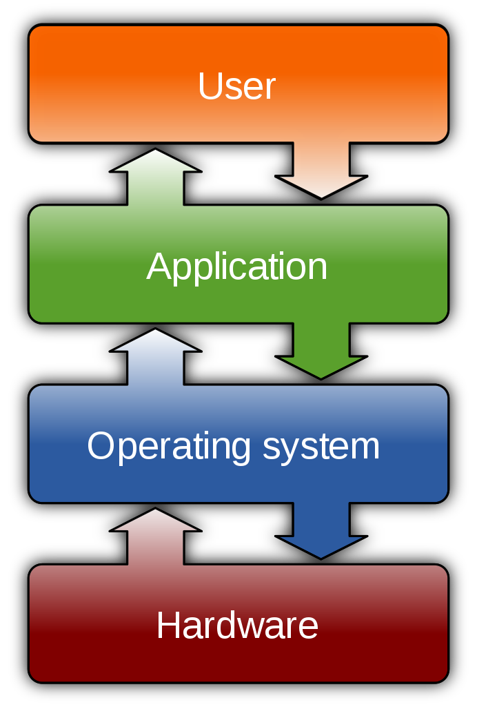
What is an Operating System?
An operating system (OS) is system software that manages computer hardware, software resources, and provides common services for computer programs
(source: Wikipedia)
OS, Spring 2021 (undergraduates)
NTUT CSIE

Slide 13
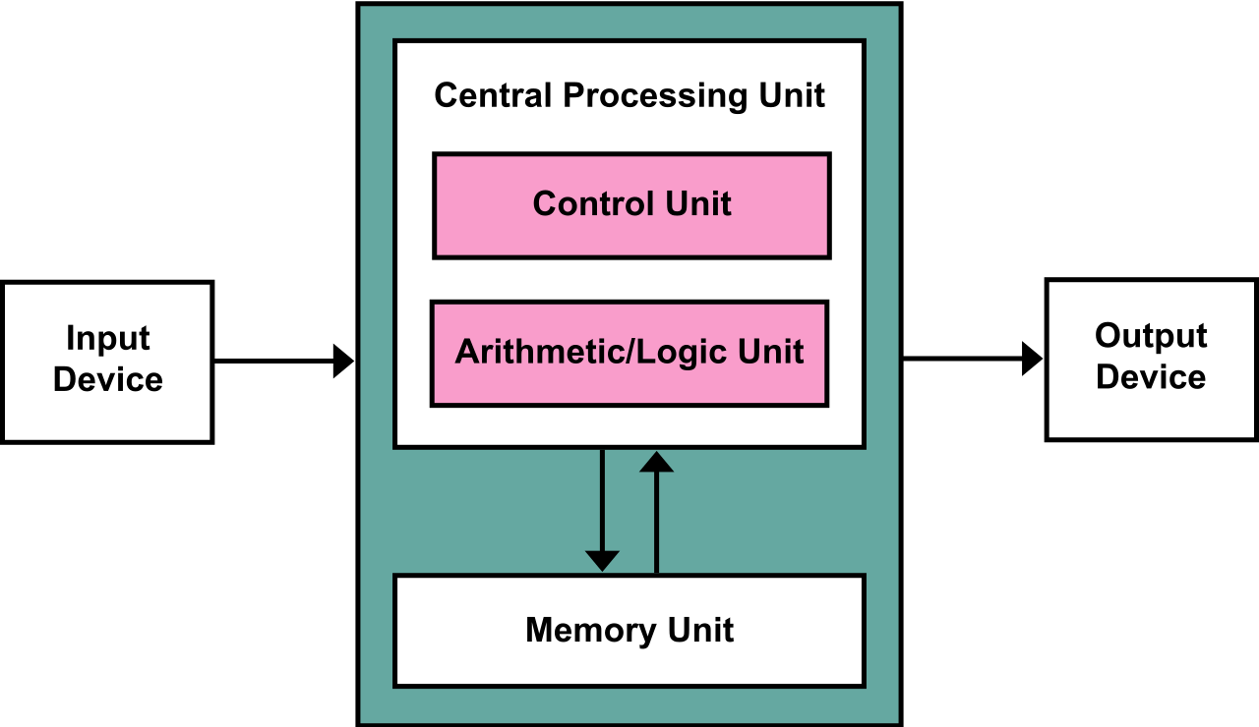
Von Neumann Architecture
Stored program architecture
Program, Input Data
Output Data
OS, Spring 2021 (undergraduates)
NTUT CSIE

Slide 14
What can you Learn?
Introduction to basic components in operating systems
  Process management
  Process synchronization
  Memory management
  Storage management
  File system
OS, Spring 2021 (undergraduates)
NTUT CSIE

Slide 15
Why do we Need an OS?
Managing limited resources
  Hardware: CPU time, memory, I/O devices
Controlling program execution
  Efficiency
  Security
  Correctness
OS, Spring 2021 (undergraduates)
NTUT CSIE

Slide 16



Do I Still Need to Learn it?
Early OS
  SHARE (1959), Multics (1963), OS/360 (1964), UNIX (1969), CP/M (1974), …
  Previous textbooks: https://codex.cs.yale.edu/avi/os-book/OS10/covers-dir/index.html
Recent growth in fundamental areas
  Multicore systems
  Mobile computing
  Virtualization
OS, Spring 2021 (undergraduates)
NTUT CSIE

Slide 17
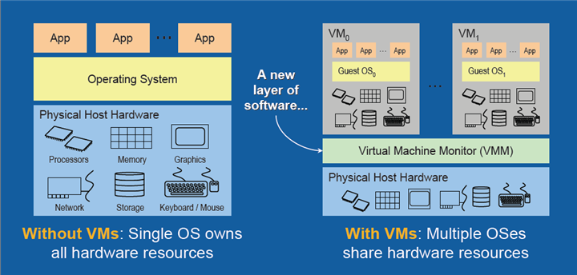
Virtualization
[Source: The Advantages of Using Virtualization Technology in the Enterprise, by Thomas Burger, Intel Developer Zone]
OS, Spring 2021 (undergraduates)
NTUT CSIE

Slide 18
Outline & Schedule
Outline: [OS10]
  Overview (Ch. 1-2)
    Introduction
    Operating System structures
  Process management (Ch. 3-5)
    Processes
    Threads and concurrency
    CPU scheduling
  Process synchronization (Ch. 6-8)
    Synchronization tools
    Synchronization examples
    Deadlocks
  Memory management (Ch. 9-10)
    Main memory
    Virtual memory
OS, Spring 2021 (undergraduates)
NTUT CSIE

Slide 19
Outline & Schedule (Cont’d)
Outline (cont’d)
  Storage management (Ch. 11-12)
    Mass storage structure
    I/O systems
  File System (Ch. 13-15)
    File system interface
    File system implementation
    File system internals
  Security and protection (Ch. 16-17) (skipped)
  Advanced topics (Ch. 18-19)
    Virtual machines
    Networks and distributed systems (skipped)
  Case studies (Ch. 20-21) (skipped)
    Linux, Windows 10
OS, Spring 2021 (undergraduates)
NTUT CSIE

Slide 20
Outline & Schedule (Cont’d)
(Tentative) Schedule
  Basics: 1-2 wks
  Process management & synchronization : 5-6 wks
  Memory management: 3-4 wks
  Midterm
  Storage management: 2-3 wks
  File system: 2-3 wks
  Virtual machines: 1-2 wk
  Final exam
OS, Spring 2021 (undergraduates)
NTUT CSIE

Slide 21
About Programming Exercises
Every student is required to do all programming exercises on his/her own
  No team work allowed
  Any programming language is acceptable
Selected from “Programming Problems” at the end of each chapter
  Tracing system calls
  Modifying Linux kernel modules
  Process management
  Inter-process communication
  Multi-threaded programs
  Semaphores
  …
OS, Spring 2021 (undergraduates)
NTUT CSIE

Slide 22
Notes on Homeworks
Rule 1: Plagiarism is prohibited
  Near-duplicate codes will get equal and minimum basic scores
Rule 2: Clear documentation is required for your program
  Instructions on downloading, installing, configuring, and executing your code and open source library, APIs, or codes must be submitted
OS, Spring 2021 (undergraduates)
NTUT CSIE

Slide 23
About the Midterm Exam
Date: Apr. 28, 2021 (TBD)
Time: 10:10-12:00am, Wednesday
Location: R227, 6th Teaching Building
Range: Ch.1-9 (TBD)
Question Types: Calculation, Short Answer, True-False, Multiple Choice
OS, Spring 2021 (undergraduates)
NTUT CSIE

Slide 24
About the Final Exam
Date: Jun. 23, 2021
Time: 10:10-12:00am, Wednesday
Location: R227, 6th Teaching Building
Range: Ch.1-15, 18 (TBD)
Question Types: Calculation, Short Answer, True-False, Multiple Choice
OS, Spring 2021 (undergraduates)
NTUT CSIE

Slide 25
Thanks for Your Attention!
OS, Spring 2021 (undergraduates)
NTUT CSIE

